Slide 1
Braindead Zombie
University Of Chittagong

Slide 2
01
Maifee Ul Asad
Our
Team Members
Mail : maifeeulasad@gmail.com
02
Naimur Rahman
Mail : naimur978@gmail.com

Slide 3
Chosen
Project
A sustainable & efficient approach to manage the traffic system in Chittagong city.

Slide 4
Yolo based Traffic Management System
(YOLOTMS)
Name of our System

Slide 5
What’s the problem?
The problem is that in the busy hour, our city's road turns into a lockdown mode at a particular moment due to the sudden heavy load of vehicle.
Most of the time, we can see that the vehicle density of all roads does not have the same frequency.
Traffic system does not know whether or not a road is confronted with traffic jam. Since it can not get any live road information, it is not possible to improvise traffic control system accordingly.

Slide 6
Our Solutions
We have exploited deep learning YOLO, a real-time object detection algorithm.
This allows the density to be fetched from the live image / video to the server in real quick.
Over a certain density limit, the corresponding routes will be blocked by red light until other bypass roads are free to ride.
If that vehicle density is below the highest limit, then the green light will automatically emit.

Slide 7
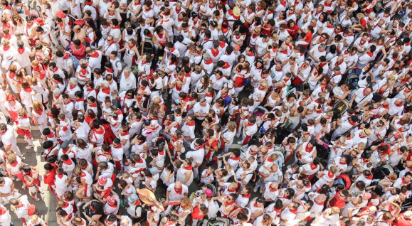

Target Audience
01
02
Citizens of our city
Traffic Authorities
It would save a lot of time.
Traffic rules will be more prioritized, if the project turns into successful project.
They can get the present scenario of the traffic.
They can get a lot of data for analysis.

Slide 8
The kind of technology we are using
Spring Boot
Django
OpenCV
YOLO
React.js
OSM
Watchdog API

Slide 9
Types of solutions which we use
We are trying to create a complete deep learning & IOT based solution in which data can be fetched using computer vision algorithms and the output will be shown in our iot device.

Slide 10
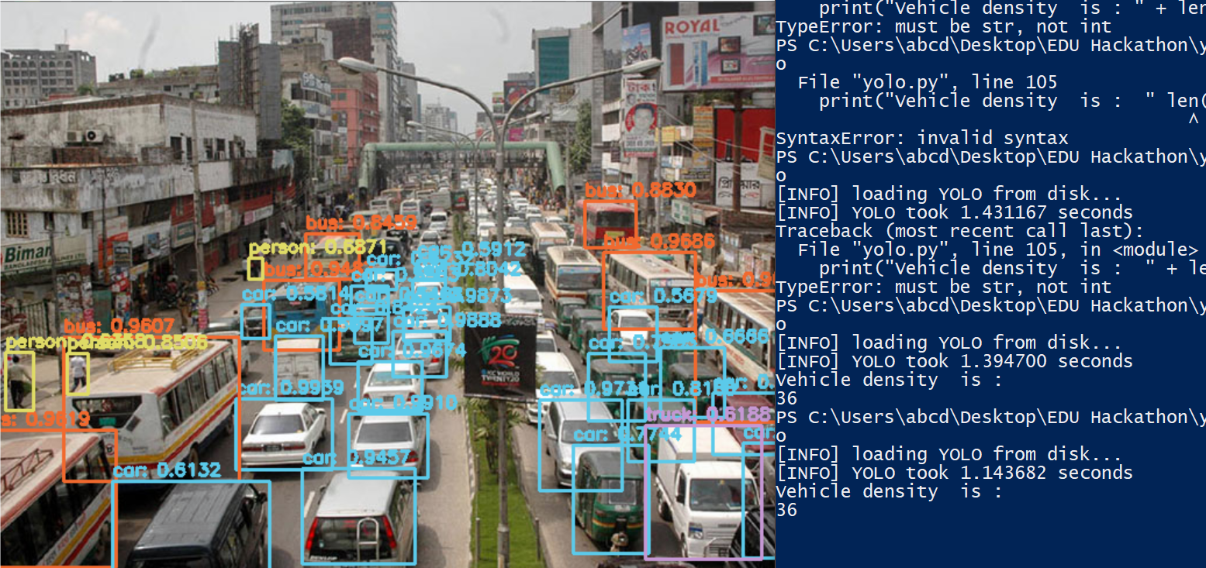
From Image

Slide 11
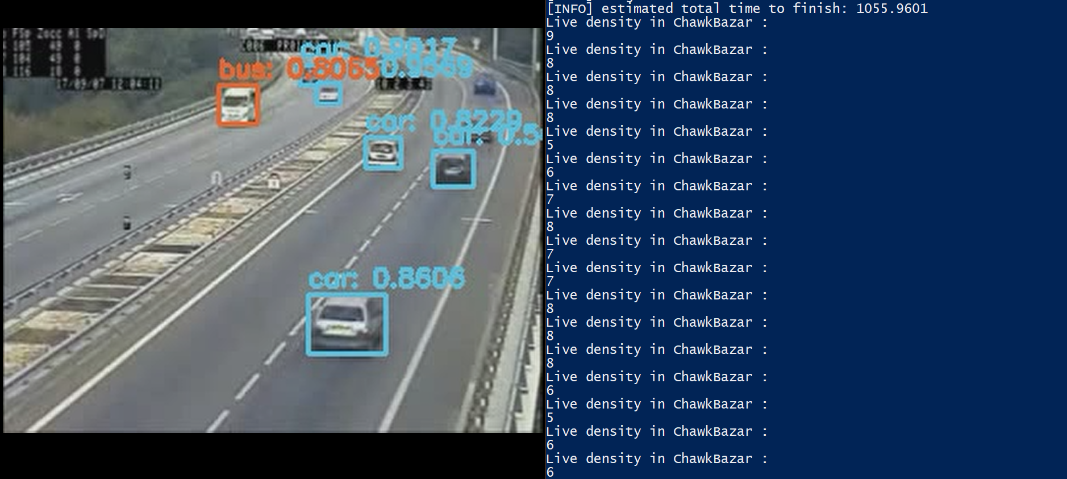
From Live Video

Slide 12
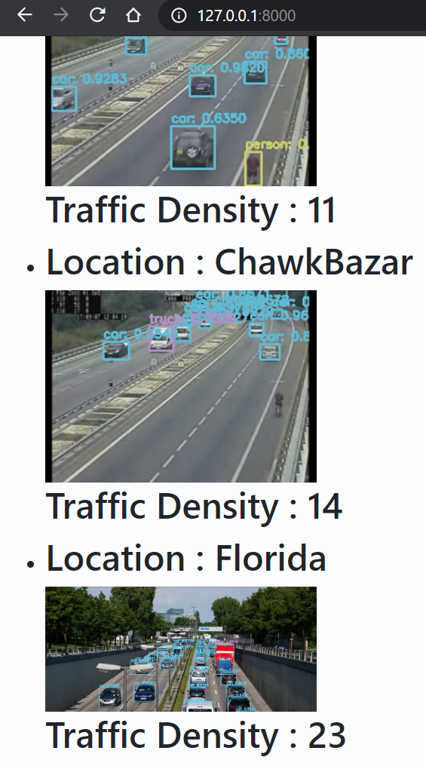
Django Server

Slide 13
Revenue Model
It’s quite a social job.
Lot of times would be saved, which is why our system can impact on our economy notably.

Slide 14
Special Requirements
Uninterrupted Internet.

Slide 15
Future Plan

Slide 16
Thank You
For Your Attention

